Slide 1

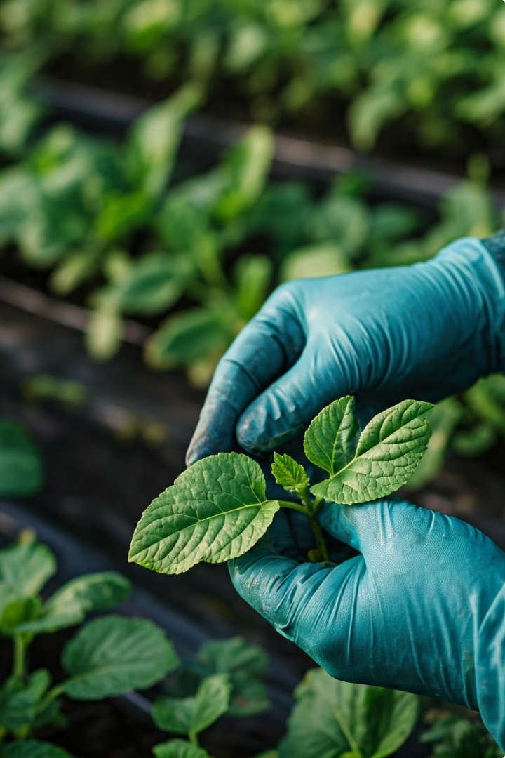

Crop Disease Detection and Crop Suggestion Tool
Empowering farmers with innovative AI solutions to enhance crop health, maximize yield, and increase farm profitability.
Crop Cure

Slide 2
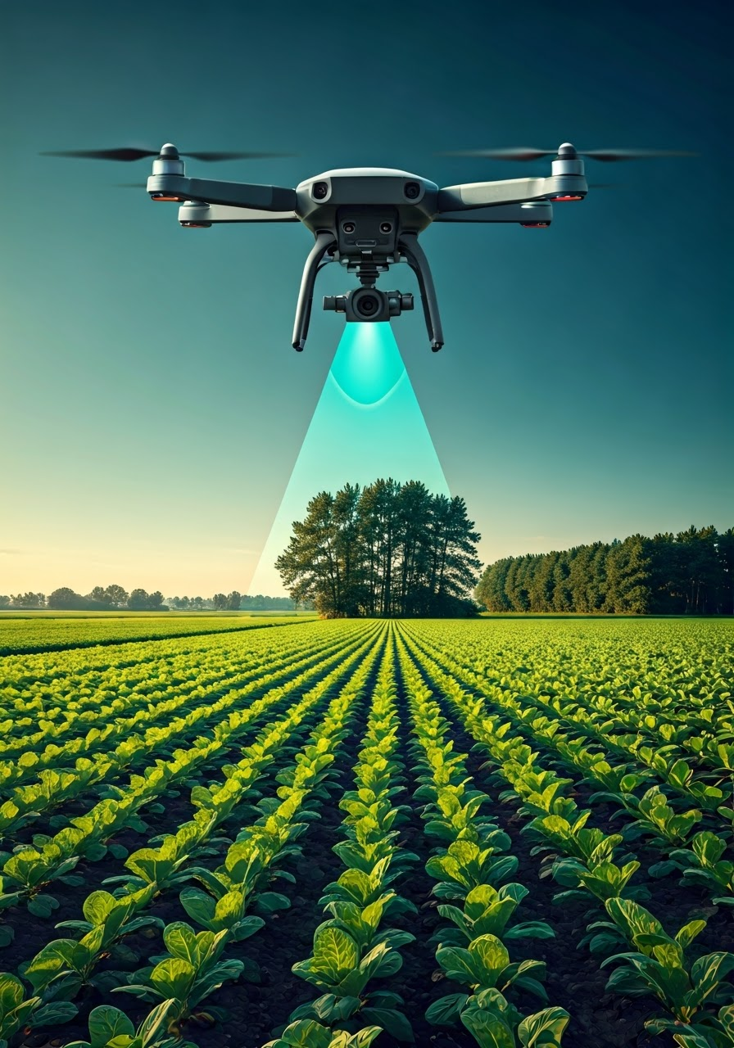
Exploring Key Aspects of AI in Agriculture
1
Brief Overview of the Project
2
Problem Statement
3
Proposed Solution
4
Who are the End-Users
5
Future Updates
6
Modelling
7
Conclusion & Insights

Slide 3
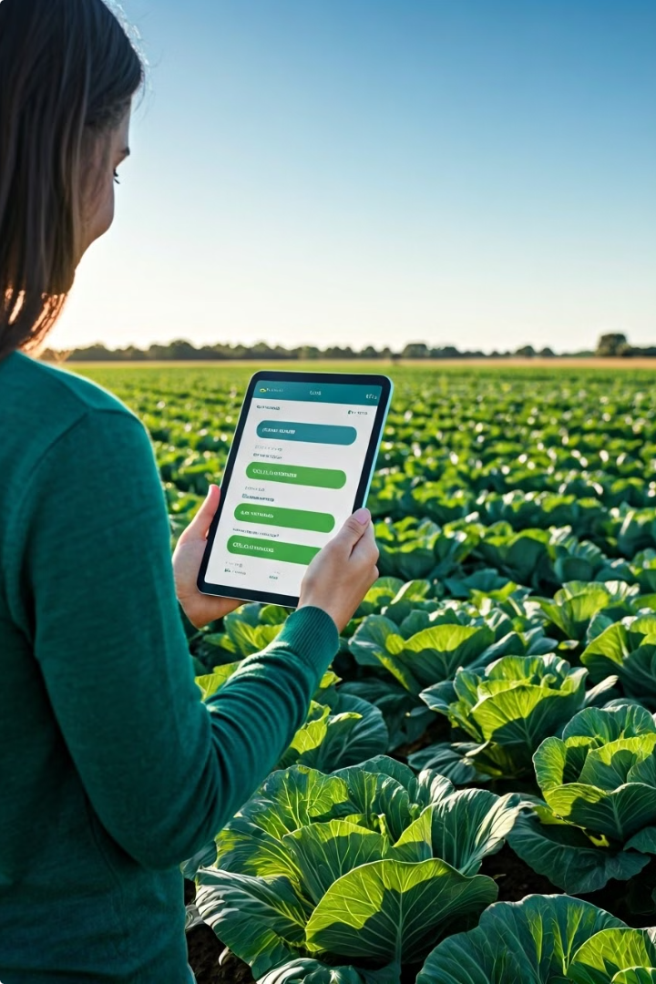
Overview of the Project
This project introduces a cutting-edge AI-powered tool that helps farmers detect crop diseases accurately and efficiently.
The tool leverages image recognition, machine learning, and data analysis to provide real-time information on potential threats to crops.

Slide 4
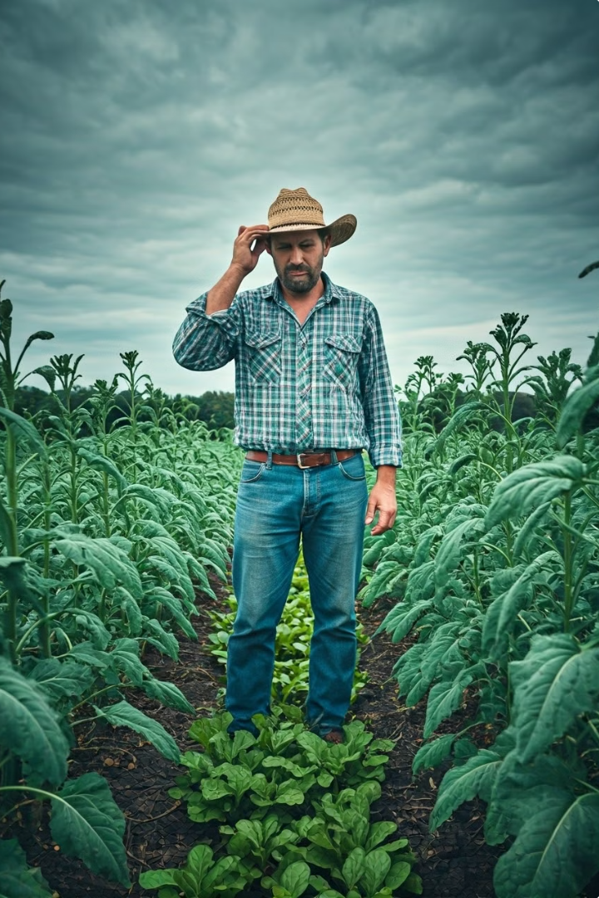
Problem Statement: Challenges Faced by Farmers and the Agricultural Sector
Slow and Inaccurate Disease Detection
Lack of Real-time Weather Information
Decreased Agricultural Productivity
Urgent Need for Advanced Disease Detection Tools

Slide 5
Proposed Solution
Our solution includes an Automated Crop Disease Detection System and a Crop Suggestion Tool.
The disease detection system uses machine learning and computer vision to diagnose crop issues from images via a mobile and web interface.
The crop suggestion tool recommends crops based on soil health, climate, and market trends, aiming to boost agricultural productivity and sustainability.
Agricultural Extension Workers
Agricultural Researchers

Slide 6
Who are the End-Users: Understanding the Diverse End-Users Roles in Agricultural Innovation
Agricultural Extension Workers
Agricultural Researchers
Smallholder farmers
Agricultural Extension workers
Agricultural Researchers
Government Agencies

Slide 7

Future Updates: Enhancing Crop Disease Detection and Farming Community Engagement
Expanded Disease Database
Community Feature
Predictive Analytics and Alerts
Integration with IoT Devices

Slide 8
Modelling: Leveraging AI for Enhanced Crop Disease Detection and Recommendation in Agriculture
Data Collection
Data Preprocessing
Model Training
Model Evaluation
Deployment and Monitoring

Slide 9
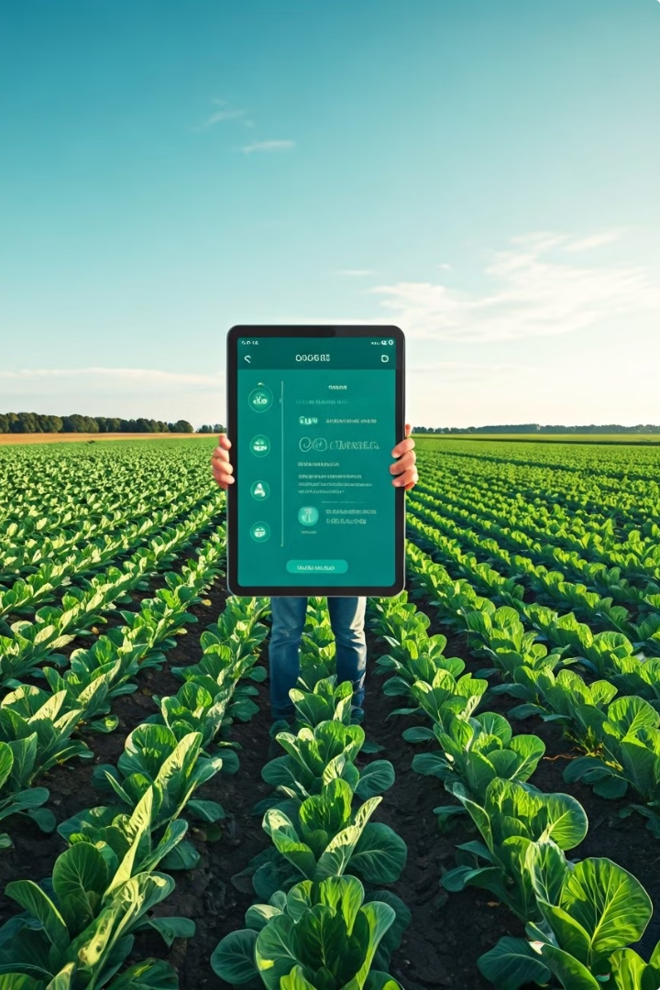
Conclusion & Insights
This innovative AI-powered tool has the potential to transform agriculture by providing farmers with the tools they need to make informed decisions about their crops.
Through accurate disease detection and personalized recommendations, the tool can help farmers protect their yields, increase profits, and improve food security.

Slide 10

THANK YOU
Crop Cure
Team SANS.AI

